Slide 1


Work-Study Counter
Work-Study Counter
Gandy Mendieta - Juan Torres - Daniel Rodriguez

Slide 2


Slide 3
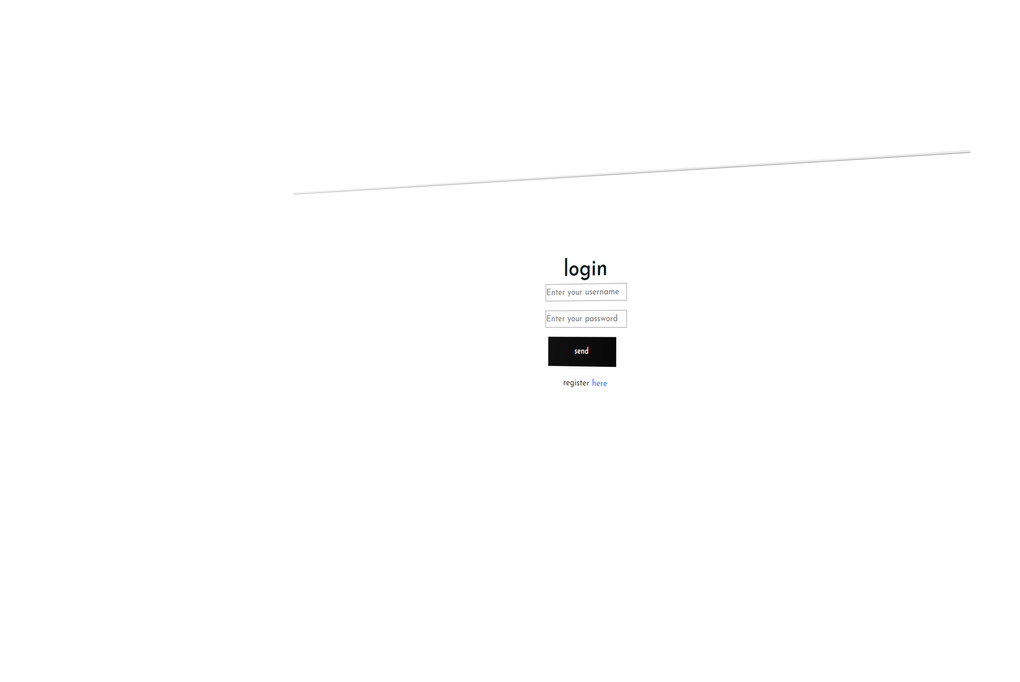



Doing an efficient work

Slide 4
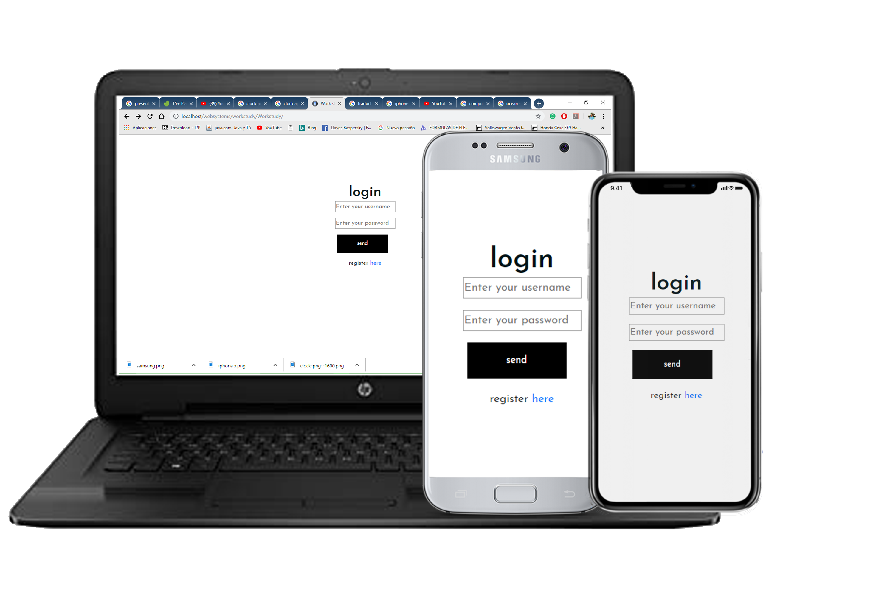
Multiplatform
Available in:
Android
Apple
Windows

Slide 5
Benefits of using this WSC
Better control- Less time spent - easy access – easy to use- minimalist interface

Slide 6
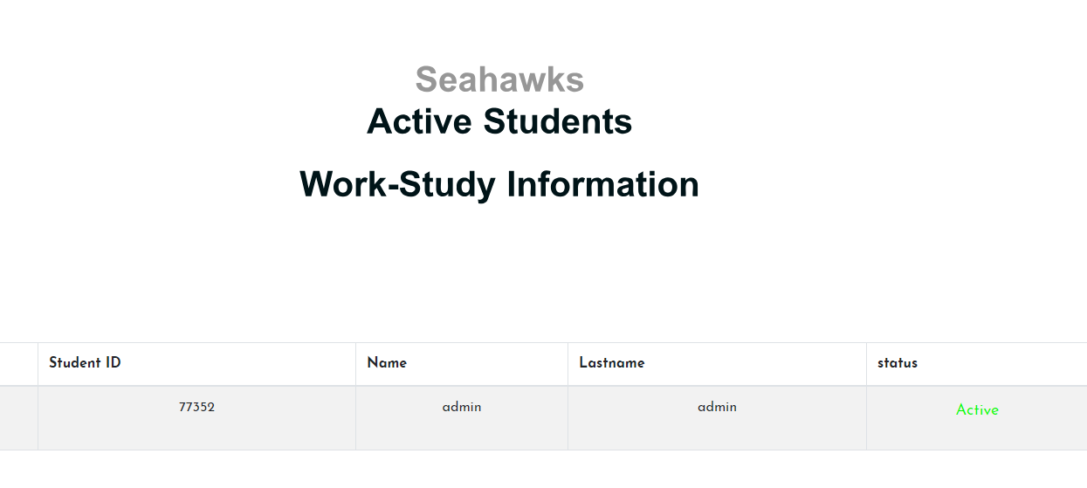
Windows to see active students

Slide 7
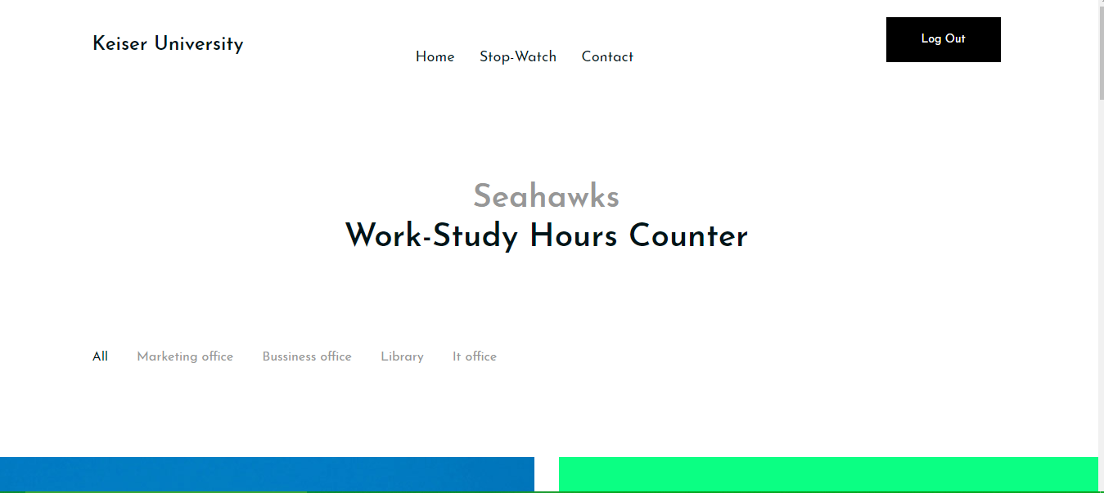
Newsletter
Where students can look for a Job vacancy

Slide 8
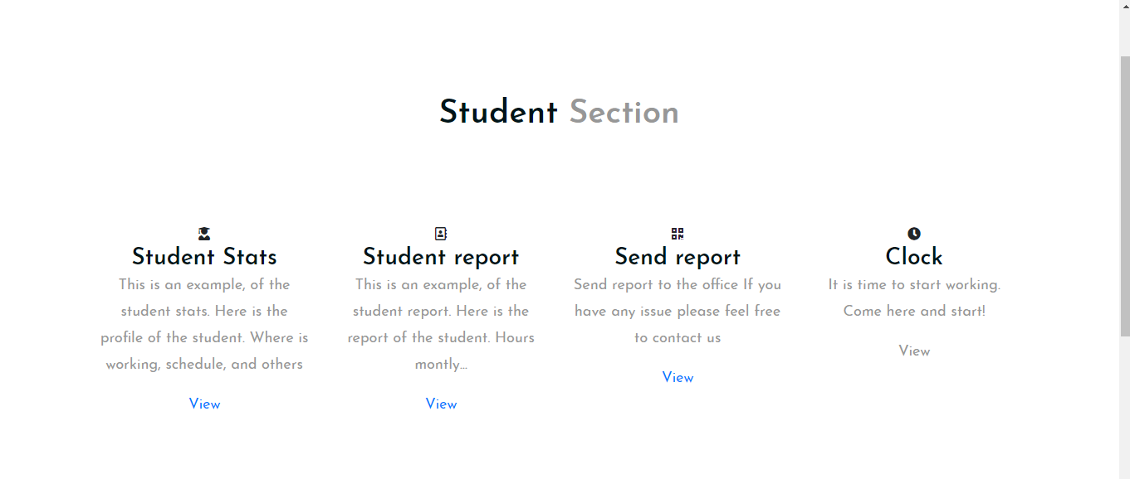
Be connected where ever you are
It is not necessary to bring
the work study sheets to
the office. Automatically,
The reports are sent to
Human Resources

Slide 9
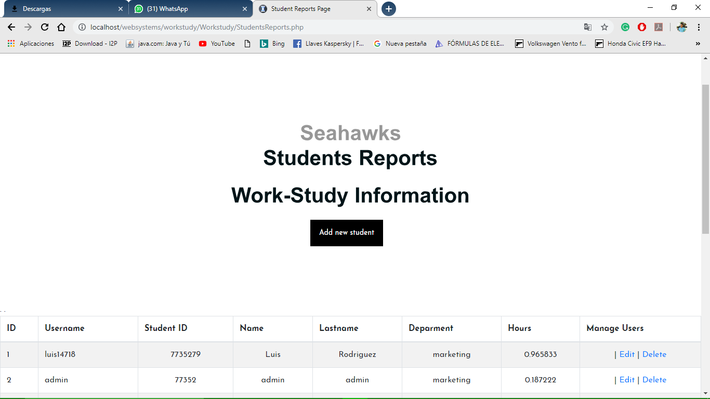
Student Report

Slide 10
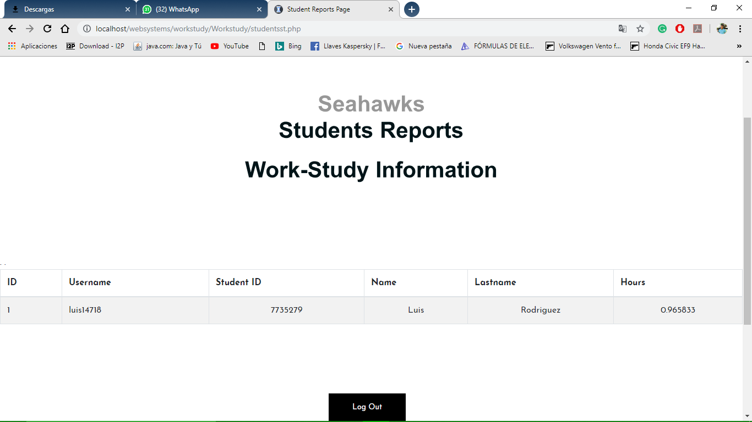
Student Report Student view

Slide 11
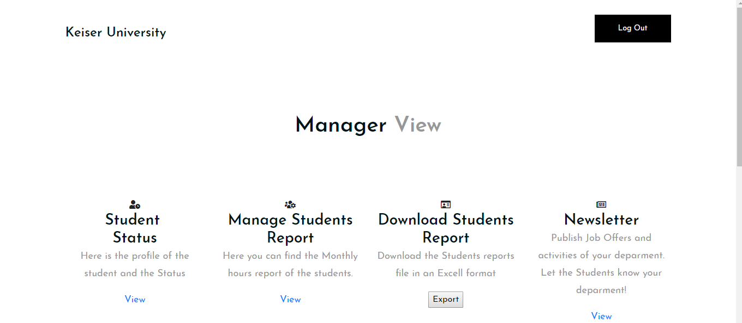
Excellent view for administrator

Slide 12

Get ready for whats next

